Slide 1
Music Genre Classification and Isolation
Paper ID: 69

Slide 2
Team Members
Adarsh.S - Computer Science and Engineering, Kumaraguru College of Technology, CBE.
Raj Senthil Kumar - Computer Science and Engineering, Kumaraguru College of Technology, CBE.
Mohsin Zahoor Peer - Computer Science and Engineering, Kumaraguru College of Technology, CBE.
Under the guidance of Dr. P. Devaki (Computer Science and Engineering, Kumaraguru College of Technology, CBE).

Slide 3
Abstract
Music classification is the classification of music based on various factors like genre, rhythmic structure, harmonic content of the music, duration or instruments played. Classification plays an important role in recommendation systems, organizing audio libraries and discovering trends and preferences. Machine Learning techniques have proved useful in music analysis and to classify music clips into different genres. In this paper, various machine learning algorithms like NN, RNN, CNN, SVC and RFC are implemented and the performance of theses algorithms are measured in terms of accuracy score and listening tests. All the models were trained on the GTZAN dataset. From analyzing the scores, the Random Forest Classifier seems to provide the best performance among the other models.
Music source separation is breaking a song into its constituent audio sources, such as the vocals, bass, and drums. It is easy to achieve if it is the original multitrack studio recordings. It is difficult to separate the sources if it's mixed into one single audio file. Convolutional Neural Network (CNN)-based source separation is tested on the MUSDB dataset in this project. The CNN model creates a binary mask for each source and it is used to create the target-extracted audio file. The performance is measured using accuracy scores and BSS-eval metrics along with listening tests. Bass masking has been found to be the best with this CNN-based masking model and the generated masks for vocals, drums and accompaniment do work but they don’t completely extract the target components.

Slide 4
Proposed System: Module 1
The GTZAN dataset which consists of 1000 audio samples is used for this module.
Various attributes like spectral centroid, spectral roll-off, spectral bandwidth, etc., are extracted from the labelled audio files.
The Random Forest Classifier is trained on this new feature-dataset.
The input (unlabelled) audio file is split into 30s chunks.
The same features are extracted from these chunks and then the pre-trained classifier model is used to predict the genre of the song.
The given audio file is classified based on a list of genres provided (10 genres- blues, rock, dance, jazz, metal, pop, reggae, hip-hop, country and classical).
Other classifiers were tested using the same method.
For the CNN model, the spectrogram representations of the samples are extracted using the STFT function and stored as images. The Standard-Scaler function is applied to standardize the data. The target for the classification models is the genre label.

Slide 5
Feature Extraction: Module 1
Mel-Frequency Cepstral Coefficients: A set of 21 features that describe the overall shape of the spectral envelope. The Mel scale relates perceived frequency, or pitch, of a pure tone to its actual measured frequency.
Spectrogram: A visual representation of the spectrum of frequencies of a signal as it varies with time. It shows frequency information across the vertical axis and time across the horizontal axis. The amplitude of frequency content is indicated by variations in color.
Spectral Centroid: Weighted mean of the frequencies present in the audio. It indicates where the center of mass of the spectrum is located. It is a good predictor of the brightness of the sound or timbre.
Zero Crossing Rate: The rate at which the signal changes from positive to zero to negative or from negative to zero to positive. There is a strong correlation between zero-crossing rate and energy distribution with frequency.

Slide 6
Feature Extraction: Module 1
Root-mean square: The RMS (Root-Mean-Square) value is the effective value of the total waveform. It is the average level of the audio signal. The reading is dependent on both the amplitude and the duration of peaks in the signal.
Spectral Roll-off: It is the frequency below which a specified percentage of the total spectral energy, e.g. 85%, lies. It’s a measure of shape of the signal.
Spectral Bandwidth: It shows the spectral spread of the signal. It shows how much the signal deviates from the spectral centroid.
Chroma Frequencies: Projection of entire spectrum into 12 bins for each semitone of an octave. These features capture harmonic and melodic characteristics of music. The main idea of chroma features is to aggregate for a given local time window, all information that relates to a given chroma into a single coefficient.
{C, C♯, D, D♯, E , F, F♯, G, G♯, A, A♯, B} - Chroma values
{..., C−2, C−1, C0, C1, C2, C3 ...} - Pitch class

Slide 7
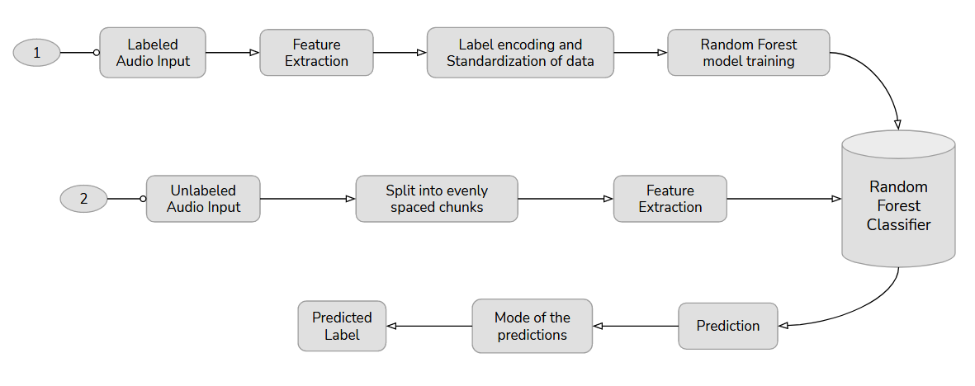
Workflow: Module 1

Slide 8
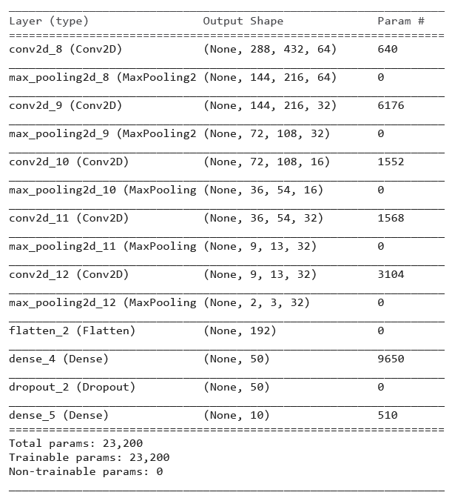
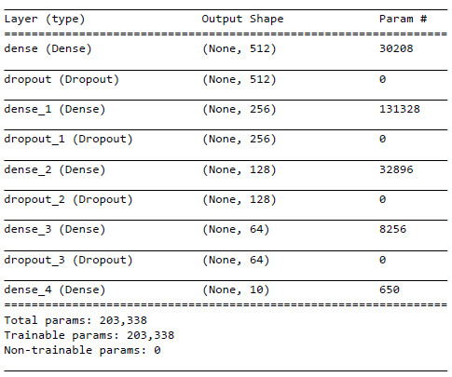
CNN Architecture: Module 1
Neural Network
CNN 2D

Slide 9
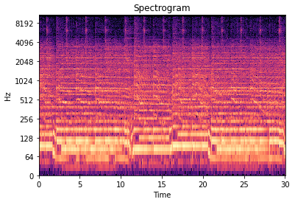
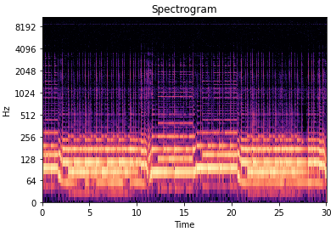
Proposed System: Module 2
The dataset has 150 tracks (90+10 for training and 50 for testing) and they are in 256kbps AAC format.
The SIGSEP MUS Cut-List Generator and Preview Generator tools are used to generate 30s previews for all the stems. The 30s stems (mixture, vocals, bass, drums, accompaniment) are converted to STFT matrices using the STFT function and then to db-scale for increase in detail.
The binary masks for the stems are created using the following formula:
total = mixture stft + target stft
binary mask = target stft < (total*0.5)
Mixture Spectrogram
Vocals Spectrogram

Slide 10
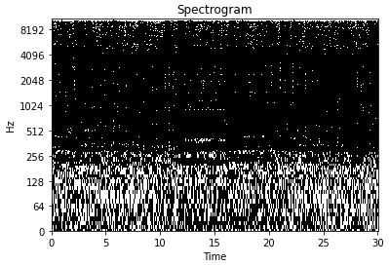
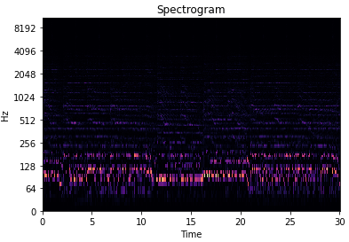
Proposed System: Module 2
Here, mixture stft is the mixture spectrogram and target stft can be the spectrogram of vocal, bass, drums or accompaniment stems.
Each STFT matrix is of size 1025*1292. 1025 is the number of rows in the stft matrix (frequency bins) and 1292 is the number of frames.
The matrix values are converted from complex to real numbers and min-max scaling is applied. The matrices are reshaped to 1292*1025*1 to train the model frame by frame.
A CNN model with the target set as one of the target binary masks is trained using the mixture STFT matrices.
Binary Mask Spectrogram
Vocal-extracted Spectrogram

Slide 11
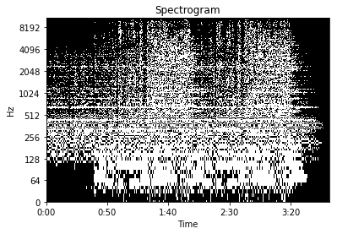
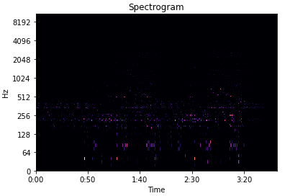
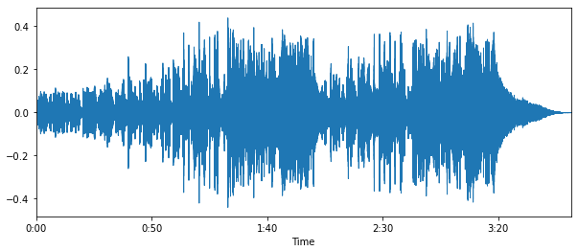
Proposed System: Module 2
The input audio file is given the same treatment as the training samples and reshaped to 1292*1025*1.
The binary mask is predicted using the CNN masking model and then reshaped back to the original dimension.
The original input audio spectrogram is multiplied with the binary mask spectrogram to obtain the target-extracted spectrogram.
Using the inverse STFT function, the spectrogram is converted to audio format.
The time series obtained is saved as a wav file using the librosa IO function.
Target Binary Mask Spectrogram
Output Spectrogram
Output Waveform

Slide 12
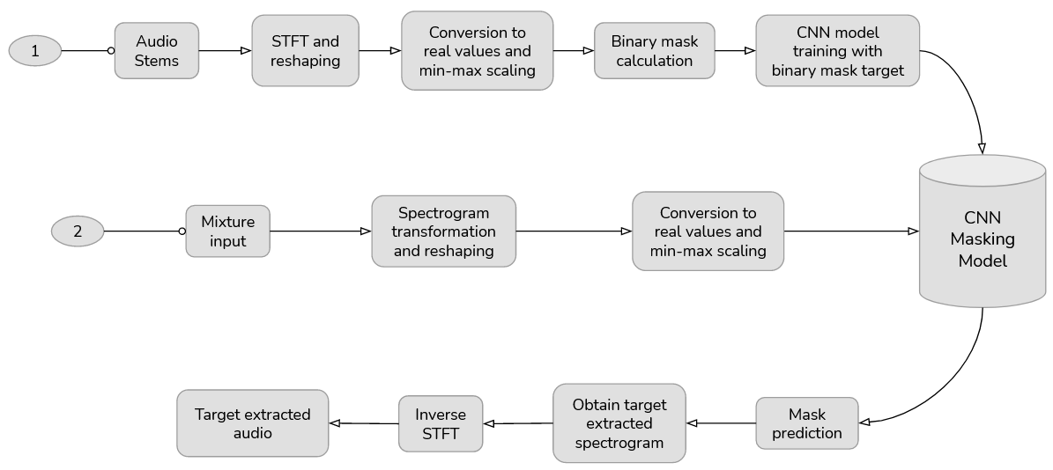
Workflow: Module 2

Slide 13
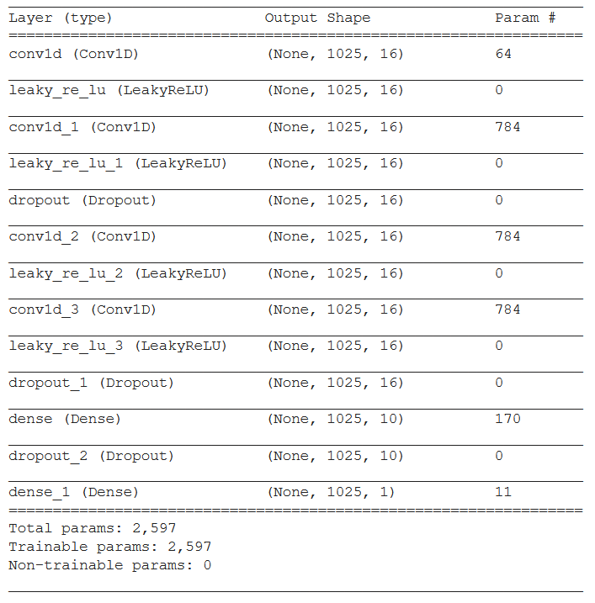
Architecture: Module 2

Slide 14
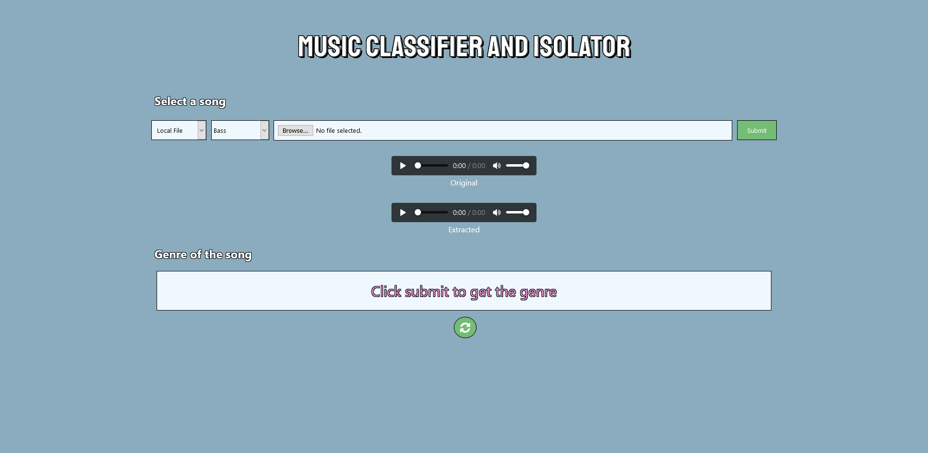
Implementation

Slide 15
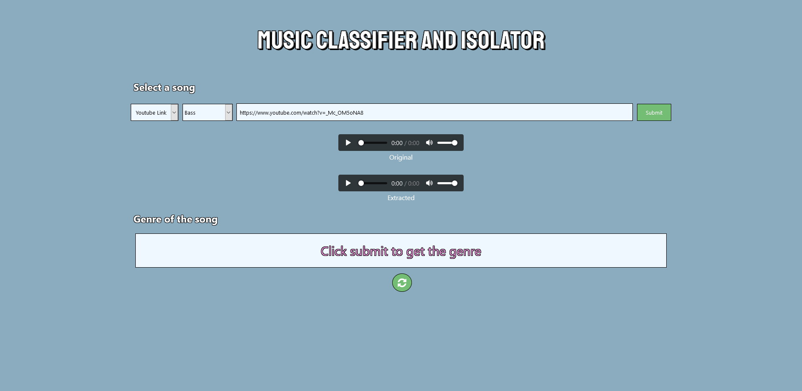
Implementation

Slide 16
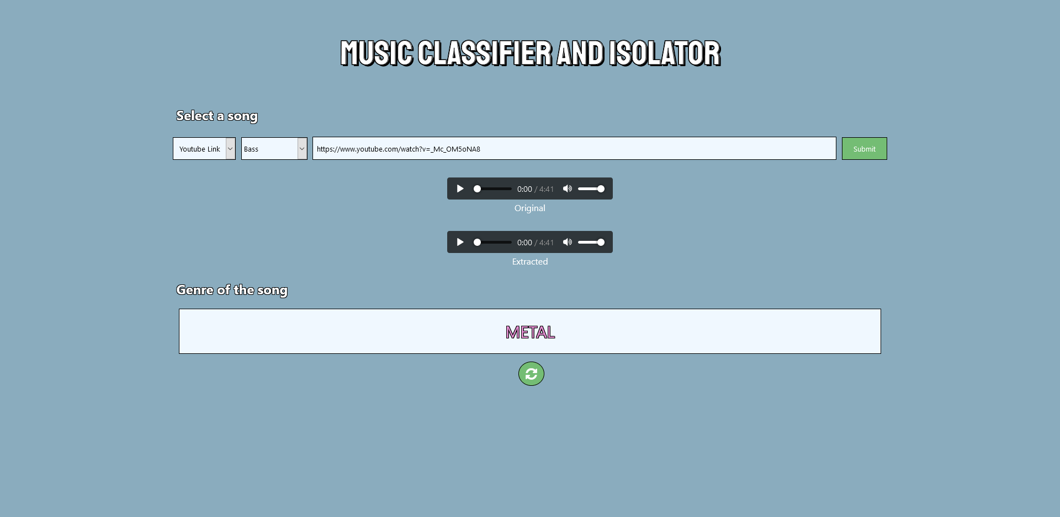
Implementation

Slide 17
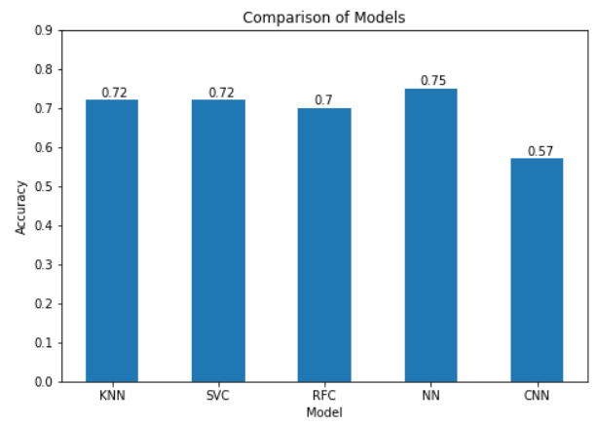
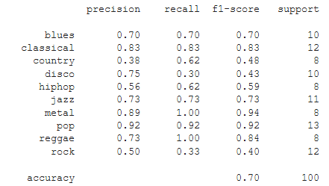
Results: Module 1
We have used the Random Forest classifier in the application instead of other classifiers we’ve tested (NN, KNN, SVC, CNN).
Even though KNN and NN have better accuracy scores than RF, it was found to classify songs better, while testing with unlabeled songs (subjective measures).
The CNN model was experimented with spectrogram representations and it provided around 98% while training but only 57% accuracy while testing. It incorrectly classified the tracks of genres like jazz, rock and country.
RFC Classification Report
Classifier Models Comparison

Slide 18
Conclusion: Module 1
RFC provided almost accurate predictions across all genres, while KNN, CNN and the Neural network models suffered while classifying the rock and metal genre.
The performance was poor for models with user audio input and it incorrectly classified a lot of genres like jazz, rock and country.
The RFC model with 70% accuracy still had better predictions over the other models (KNN- 72%, SVC- 72%, NN- 75%) by weighing in opinionated scores.
This can be due to these genres having a balanced energy distribution across all frequencies.
By inspecting the spectrograms, it was noticed that rock and metal songs did not have the visible beats or other distinctive traits that can be noticed in other genres. It also encompasses a lot of different styles (hard, soft, progressive, etc.).
The RFC model was the only classifier that classified these songs accurately, even though other models had more accuracy while training.

Slide 19
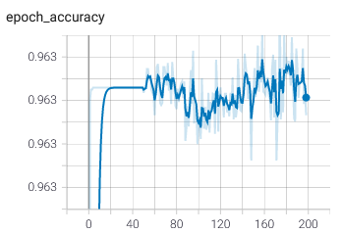
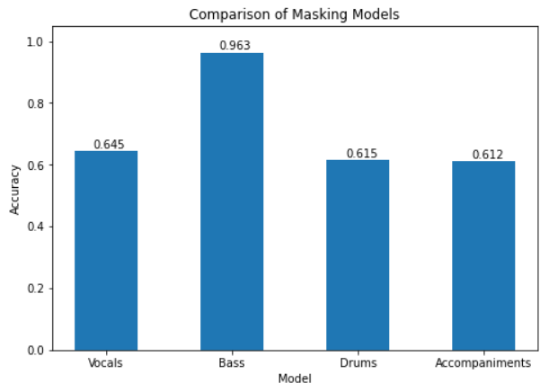
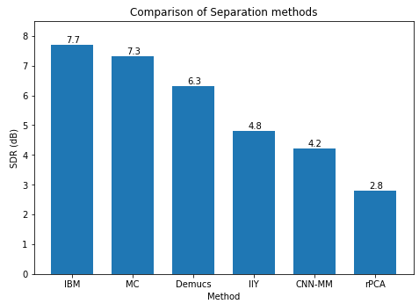
Results: Module 2
With respect to the CNN Masking model, an average SDR of around 2.5~4dB was achieved, calculated using BSS Eval.
Extraction of bass from the mixture worked the best but other targets such as vocals, drums and other accompaniments were not extracted completely.
The mask did manage to at least reduce the volume of the target components by a significant amount.
The masking model for bass had significantly higher accuracy than the other masking models.
Bass Masking Model Accuracy
Masking Models Comparison
Separation Methods Comparison

Slide 20
Conclusion: Module 2
The CNN masking model is focused on source separation in the frequency domain, which assumes that the frequency components of the targets are non-overlapping.
Bass is easier to isolate than other targets since the frequencies fall within a specific range and are not distributed across the whole spectrum.
Other targets like vocals have frequency components in a wider range since there are overtones and undertones along with the fundamental frequency. This overlaps with other targets like drums and accompaniments that also have a wide frequency range. Hence it is harder to separate these targets as opposed to bass.
Also, time-frequency methods like this generate some artifacts (noise) in the output, unlike beamforming/waveform methods. The quality of separation using these methods are still not good enough for applications like karaoke or sampling.
The current model can be improved with a better binary mask generation for the training set, increasing the training set, using noise filters in post-processing and by including recent architectures.

